Slide 1


WELCOME
DIFFERENT TYPES OF
NETWORKING
REPRESENTED BY PRAKASH SAHU

Slide 2
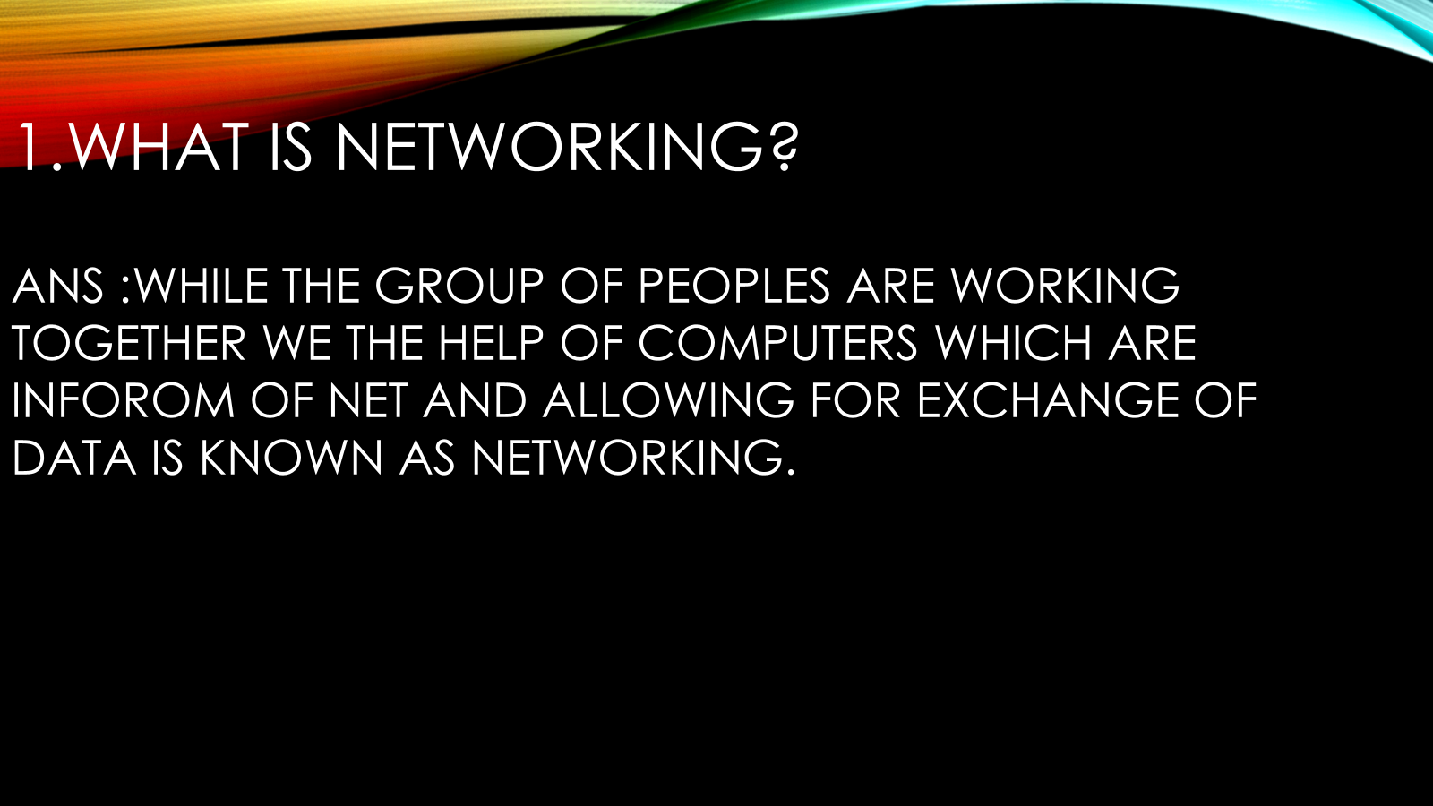

Slide 3

WHAT ARE THE TYPES OF NETWORKING?
THERE ARE SIX TYPES OF NETWORKING GIVEN BELOW
1.LAN
2. PAN
3.CAN
4.MAN
5.WAN
6.SAN

Slide 4

LAN(LOCAL AREA NETWORK)
a.IN THIS FIELD OF NETWORK LAN STAND FOR LOCAL AREA NETWORK.
b.IT IS APPLICABLE WITH IN RANGE 1-2KMS ACCROS GEOGRAPHICAL AREA.
c.THE DATA TRANSMITTED SPEED RATE FOR LAN HIGHER AND LOSE OR DAMAGE OF DATA IS MINIMUM.
d.THE POSSIBILITY ERROR IN CASE OF LAN IS NEGLIGIBALE AND IT WII COVER THRE SHORTEST DISTANCE.
d.IT IS BASICALLY 4 TYPES LIKE STAR LAN,BUS LAN,MERSH LAN,RING LAN.
c.IT IS BASICALLY USED IN RAILWAY STATION AND EDUCATION SECTOR ETC.

Slide 5

WAN(WIDE AREA NETWORK)
a) IN THIS FIELD OF NETWORK WAN STAND FOR WIDE AREA NETWORK.
b) IT IS APPLICABLE WITHIN RANGE OF 2-KMS OR EVEN WORLD WIDE CONNECTION I.E WWW
c) THE DATATRANSMITTED SPEED RATE OF WAN IS LOWER AND THE LOSE OR DAMAGE OF DATA IS MAXIMUM.
d) THE POSSIBILITY ERROR PRESEN IS CASE OF WAN IS NEGLIGIBLE AND IT WILL COVER WTIDEER DISTANCE
e) NO TYPE OF CLASSIFICATION BUT MORE THAN ONE LAN IS CALLED WAN.

Slide 6

Man(metropolitian area network)
1.IN THIS FIELD OF NETWORK MAN STAND FOR METROPOLITIAN NETWORK.
2.IT IS THE COMMON FEATURES BOTH LAN AND WAN IS CALLED MAN.
3.IT IS USED METROPOLITIEAN AREA LIKE MUBAI,HYDRABAD ETC.
4.THE DATA TRANSMISSIN SPEED RATE OF MAN IS LESS THAN LAN BUT MORE THAN WAN.
5.THE LOSS OR DAMAGE OF DATA IN CASE OF WAN IS MORE THAN LAN BUT LESS THAN WAN

Slide 7

PAN(PERTIONAL AREA NETWORK)
aIN THIS FIELD OF NETWORK PAN STAND FOR PERTIONAL AREA NETWORK.
IT IS APPLICABLE WITHIN THE RANGE OF 10 METER OR 33 FEETS.
IT IS TYPICALLY INVOLPS A COMPUTER ,PHONE,TABLET ETC.
IT IS VERY USEFULL IN HOME,OFFICES AND SMALL NETWORK AREA DUE TO ITS HIGH PERFORMANCE.

Slide 8

CAN(CAMPOUS AREA NETWORK)
a)IN THIS FIELD OF NETWORK CAN STAND FOR CAMPOUSE AREA NETWORK.
b) High-speed data transmission (up to 1 Mbps)-
c)Priority-based message transmission-
d)Multi-master architecture

Slide 9

San(storage area network)
.High-performance data transfer (up to 32 Gbps)
Low latency
Centralized data management
Scalability and reliability

Slide 10

THANK
YOU

